Slide 1



Practical 1 Preparing and QC of sequence data

Slide 2
Learning points
Understand read file formats
How to judge a QC report
How to filter/trim Illumina reads

Slide 3
Formats
sff (454)
fasta + qual
fastq

Slide 4
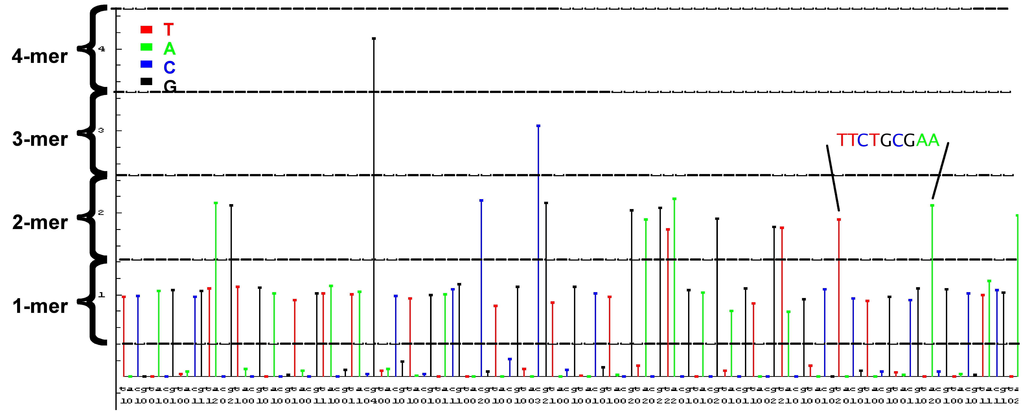
Datafiles 454
sff file (standard flowgram format)
binary
fasta & qual
text

Slide 5
454: sff file (text format)
>F7K88GK01BMPI0
Run Prefix: R_2009_12_18_15_27_42_
Region #: 1
XY Location: 0551_2346
Run Name: R_2009_12_18_15_27_42_FLX########_Administrator_yourrunname
Analysis Name: D_2009_12_19_01_11_43_XX_fullProcessing
Full Path: /data/R_2009_12_18_15_27_42_FLX########_Administrator_yourrunname/D_2009_12_19_01_11_43_XX_fullProcessing/
Read Header Len: 32
Name Length: 14
# of Bases: 500
Clip Qual Left: 15
Clip Qual Right: 490
Clip Adap Left: 0
Clip Adap Right: 0
Flowgram: 1.03 0.00 1.01 0.02 0.00 0.96 0.00 1.00 0.00 1.04 0.00 0.00 0.97 0.00 0.96 0.02 0.00 1.04 0.01 1.04 0.00 0.97 0.96 0.02 0.00 1.00 0.95 1.04 0.00 0.00 2.04 0.02 0.03 1.05 Flow Indexes: 1 3 6 8 10 13 15 18 20 22 23 26 27 28 31 31 34 35 37 37 37 40 43 45 47 47 47 50 53 53 53 55 58 60 63 66 67 67 67 67 70 71 71 74 74 76 79 82 83 86 86 88 88 91 93 96 97...
Bases: tcagatcagacacgCCACTTTGCTCCCATTTCAGCACCCCACCAAGCACAAGGCTGTCATCCCAATTGGACGGACAGATATGAGGTTAGCATTGGAAACCAATTCAGTCCCTAATTATTCACGACTGAACCCAGCGACAATTGGACATGGATTCATTTTTCAACTTGATTTGTTGTTGTAAAAGCA...
Quality Scores: 40 40 40 40 40 40 40 40 40 40 40 40 40 40 40 40 40 40 38 38 38 40 40 40 39 39 39 40 34 34 34 40 40 40 40 39 26 26 26 26 40 40 40 40 40 40 40 40 40 40 40 40 40 40 40 40 40 40 40 40 ...

Slide 6
454: fasta and qual files
Fasta:
>FTJD6BE02HHD3W length=409 xy=2951_1562 region=2 run=R_2009_04_01_11_28_49_
AGAAAGTCAGCGGCAAATTTGGTTTTAGACGAATTGTCCCTTTGACATAACGACTAAAGG
AGTCAACAGATTTTCGTATAACTTCGTATAATGTATGCTATACGAAGTTATTACGCTATT
...
Qual:
>FTJD6BE02HHD3W length=409 xy=2951_1562 region=2 run=R_2009_04_01_11_28_49_
40 40 39 39 39 40 40 40 40 40 40 40 40 38 31 26 26 16 16 16 20 20 14 14 14 14 27 33 32 35 36 33 36 35 36 38 35 20 20 21 24 24 22 36 39 40 38 38 38 40 40 40 40 40 40 37 37 37 33 33
29 36 38 38 38 38 38 38 38 35 20 21 21 21 31 36 37 40 40 35 37 37 40 40 40 40 40 40 40 40 40 40 40 40 40 40 40 40 40 40 40 40 40
...
Sanger-style Phred scores

Slide 7
Quality scores
Phred-based
http://en.wikipedia.org/wiki/Phred_quality_score
Phred Quality Score | Probability of incorrect base call | Base call accuracy
10 | 1 in 10 | 90 %
20 | 1 in 100 | 99 %
30 | 1 in 1 000 | 99.9 %
40 | 1 in 10 000 | 99.99 %
50 | 1 in 100 000 | 99.999 %

Slide 8
Illumina: fastq file
@PCUS-319-EAS487_0004_FC:6:1:1351:952#0/1
CCAACATAGCTGGATGCCAACATAGCTGGATTGTTATAGCTGGTTTGCTTTTCTAACTCGCTGGAAGTTTATAAGCATTCCTACTATTTCATAGTATTAC
+@PCUS-319-EAS487_0004_FC:6:1:1351:952#0/1
BBbfYcbV^BV`cQffaBZfB_fdfUYaa]`adcbfef\acfd^cad^fOabRceb`beSbdfaad_e^^dbeedTbd`V\ecdfffYBddb^fa\d\de

Slide 9
Illumina: fastq file
@PCUS-319-EAS487_0004_FC:6:1:1351:952#0/1
CCAACATAGCTGGATGCCAACATAGCTGGATTGTTATAGCTGGTTTGCTTTTCTAACTCGCTGGAAGTTTATAAGCATTCCTACTATTTCATAGTATTAC
+@PCUS-319-EAS487_0004_FC:6:1:1351:952#0/1
BBbfYcbV^BV`cQffaBZfB_fdfUYaa]`adcbfef\acfd^cad^fOabRceb`beSbdfaad_e^^dbeedTbd`V\ecdfffYBddb^fa\d\de
Sequence
Quality

Slide 10
Illumina: fastq file
@PCUS-319-EAS487_0004_FC:6:1:1351:952#0/1
CCAACATAGCTGGATGCCAACATAGCTGGATTGTTATAGCTGGTTTGCTTTTCTAACTCGCTGGAAGTTTATAAGCATTCCTACTATTTCATAGTATTAC
+@PCUS-319-EAS487_0004_FC:6:1:1351:952#0/1
BBbfYcbV^BV`cQffaBZfB_fdfUYaa]`adcbfef\acfd^cad^fOabRceb`beSbdfaad_e^^dbeedTbd`V\ecdfffYBddb^fa\d\de
Quality score as characters:
Phred score = ASCII value -33
'B' is ASCII 66 → Phred 33

Slide 11
Illumina: fastq file
Different schemes
Sanger ASCII = Phred + 33
Illumina 1.3+ ASCII = Phred + 64
Illumina 1.8+ Same as Sanger

Slide 12
Illumina: fastq file
@PCUS-319-EAS487_0004_FC:6:1:1351:952#0/1
CCAACATAGCTGGATGCCAACATAGCTGGATTGTTATAGCTGGTTTGCTTTTCTAACTCGCTGGAAGTTTATAAGCATTCCTACTATTTCATAGTATTAC
+@PCUS-319-EAS487_0004_FC:6:1:1351:952#0/1
BBbfYcbV^BV`cQffaBZfB_fdfUYaa]`adcbfef\acfd^cad^fOabRceb`beSbdfaad_e^^dbeedTbd`V\ecdfffYBddb^fa\d\de
Matching pair in the other file:
+@PCUS-319-EAS487_0004_FC:6:1:1351:952#0/2

Slide 13
FastQ formats
Cock PJ et al 2009
The Sanger FASTQ file format for sequences with quality scores, and the Solexa/Illumina FASTQ variants.
Nucleic Acids Res. 2010 Apr;38(6):1767-71.
and
http://en.wikipedia.org/wiki/Fastq

Slide 14
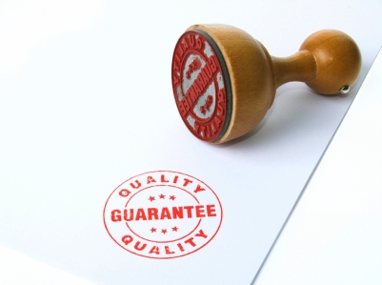
Quality control

Slide 15
Quality Control
454 (and others): Prinseq
Illumina (and others): fastQC, fastQA, etc

Slide 16
Prinseq
http://edwards.sdsu.edu/prinseq_beta
Web-based and stand-alone
Upload
fasta or fastq file
qual file (optional)

Slide 17
Prinseq
Demo
→the 454 GS FLX+ shotgun reads for this course

Slide 18
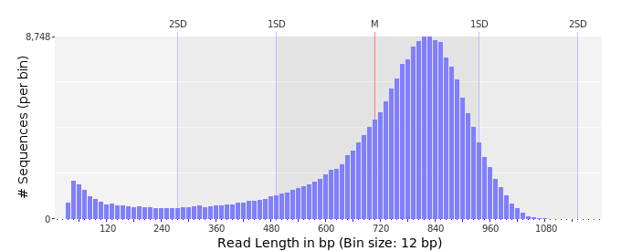
Prinseq: read length

Slide 19
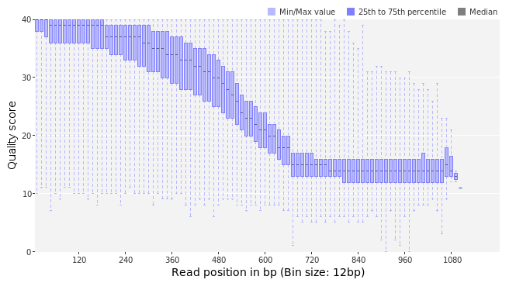
Prinseq: quality per position

Slide 20
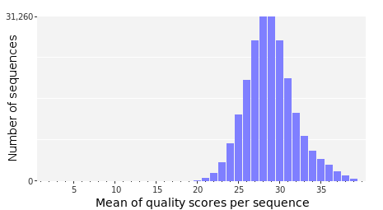
Prinseq: quality values

Slide 21
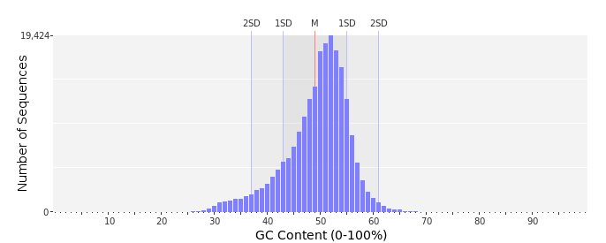
Prinseq: GC content

Slide 22
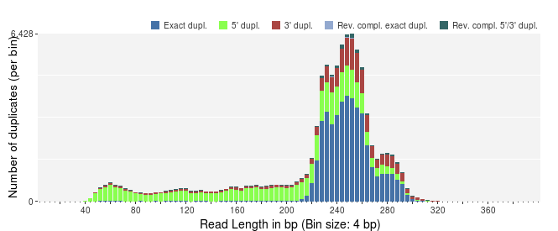
Prinseq: duplicate reads
Expected

Slide 23
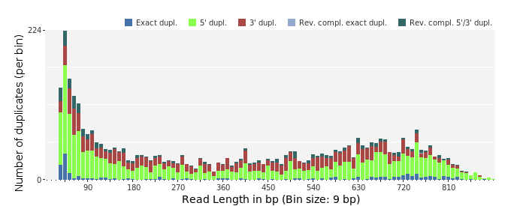
Prinseq: duplicate reads
Observed

Slide 24



Prinseq: adaptors
No tag
Barcode (Roche 'MID')
Transcriptome library adaptor

Slide 25
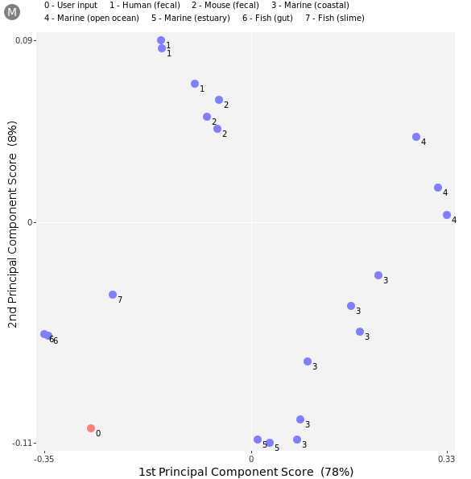
Prinseq: contamination
The dinucleotide
odds ratios*
Principal component analysis (PCA)
*dinucleotide frequencies normalized for the base composition

Slide 26
FastQC
http://www.bioinformatics.bbsrc.ac.uk/projects/fastqc/
Stand-alone
GUI (Java based)
Use
fastq file
BAM/SAM

Slide 27
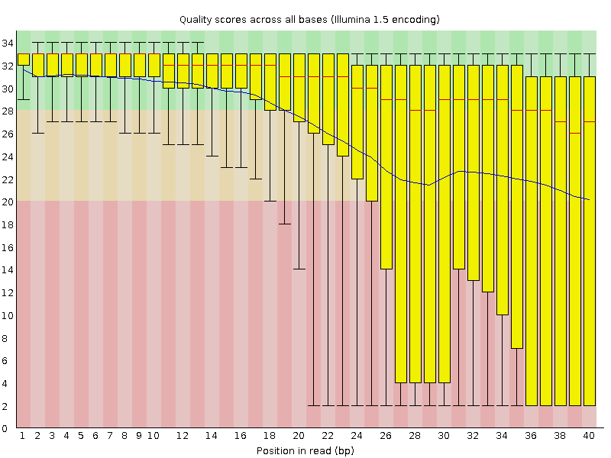
FastQC: quality per position

Slide 28
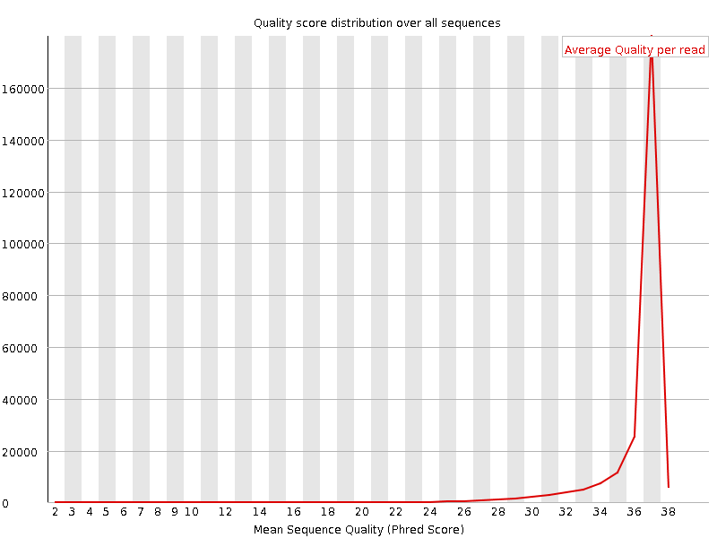
FastQC: quality values

Slide 29
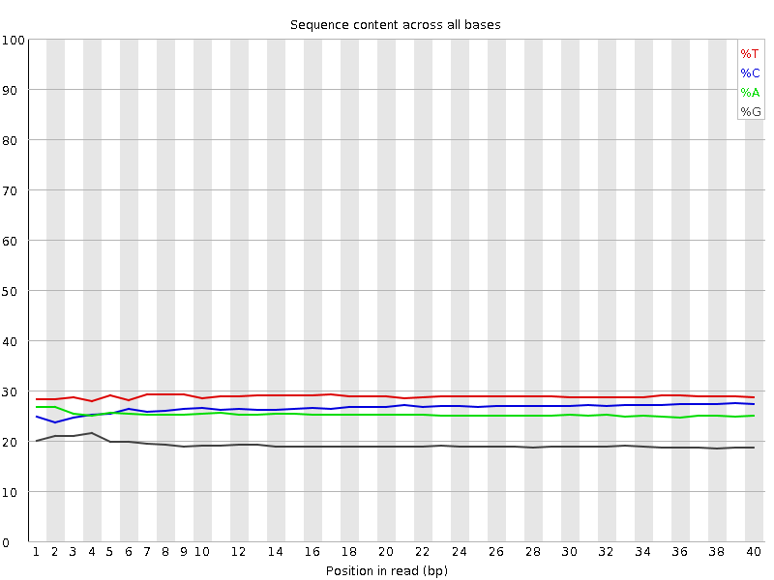
FastQC: nucleotide composition

Slide 30
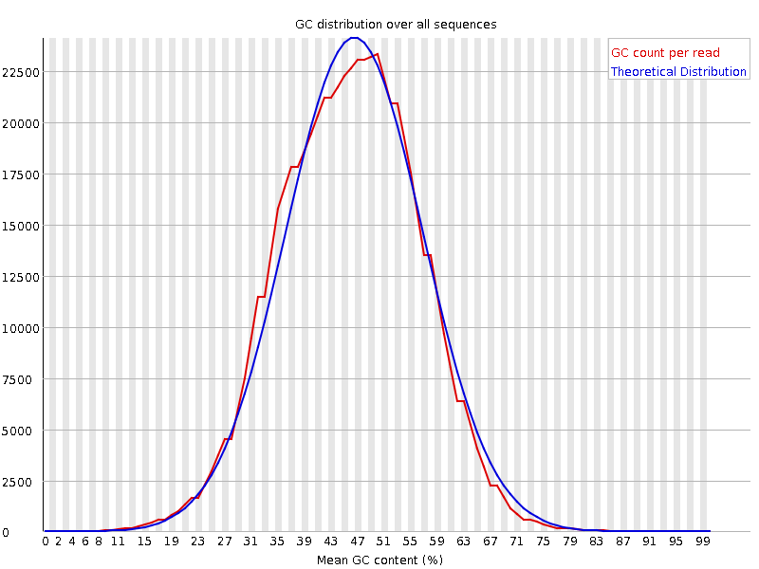
FastQC: GC distribution

Slide 31
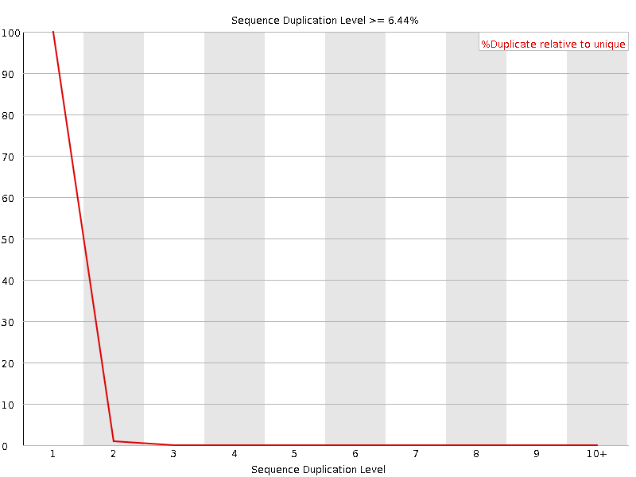
FastQC: duplicated reads

Slide 32
Filtering/trimming
Adaptor removal
especially Illumina
Duplicate removal
Filtering for low quality bases
or stretches of them
reads with 'N's
E.g.
fastX toolkit
prinseq

Slide 33
Practical 1
FastQC on MiSeq run
Filtering/trimming
Redo FastQC on filtered reads

